Slide 1
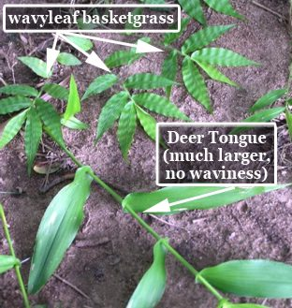
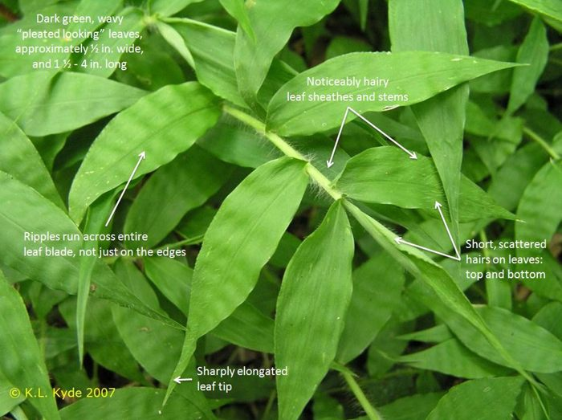
Attention SCBI Staff:
Wavyleaf bastketgrass, a new and highly invasive exotic grass, was discovered recently in the Posey Hollow forest. If you see this plant anywhere on SCBI grounds, please note its location and inform Norm Bourg or Bill McShea.
Because WLBG is still rare and scattered in most areas, it is still possible to curb its spread across Virginia and help keep our local forests healthy.
Please avoid walking in it at this time of the year, because its seeds are sticky!
We would really appreciate your help in fighting this new threat to SCBI forests!
See additional information and identifying characteristics below:

